Slide 1
CSE 3100
Lecture 2
Introduction to Laravel

Slide 2
Lecture plan
Types of websites
Difference between CSR & SSR
Architecture of a full stack application
What are Frameworks?
Introduction to Laravel
What is Composer?
What is Inertia?
Directory structure
Laravel Routing System (Web & API)
Testing APIs using Postman
Project proposal guidelines and impact
Prepared by: Ali Ahnaf

Slide 3
Types of websites
Two categories of websites exists:
Static: consist of fixed content that is the same for every user. These sites are typically created using HTML, CSS, and sometimes JavaScript. The content does not change unless the developer manually updates the files. No database or server-side processing is involved. The pages are pre-built and served as-is to users.
Dynamic (Web apps): Dynamic websites generate content in real-time, often tailored to individual users. These sites use server-side scripting and databases to deliver personalized experiences. Content is generated dynamically based on user interactions, preferences, or other criteria.
Prepared by: Ali Ahnaf

Slide 4
Approaches of rendering sites
Two common types of rendering exists:
Client-Side Rendering (CSR): The server sends a bare-bones HTML file and JavaScript bundles, and the browser dynamically generates the final HTML. Initial load time is higher but subsequent loads are faster. Poor SEO performance unless server-side pre-rendering or hydration techniques are used, as search engines may struggle with JavaScript-heavy content
Server-Side Rendering (SSR): SSR generates the content on the server and sends fully-rendered HTML to the client. The browser displays the content immediately. Better SEO performance because search engine crawlers can easily index the fully-rendered HTML.
Q: Which technique has the higher network overhead?
Read more: Understanding the Difference between CSR and SSR Rendering
Prepared by: Ali Ahnaf

Slide 5
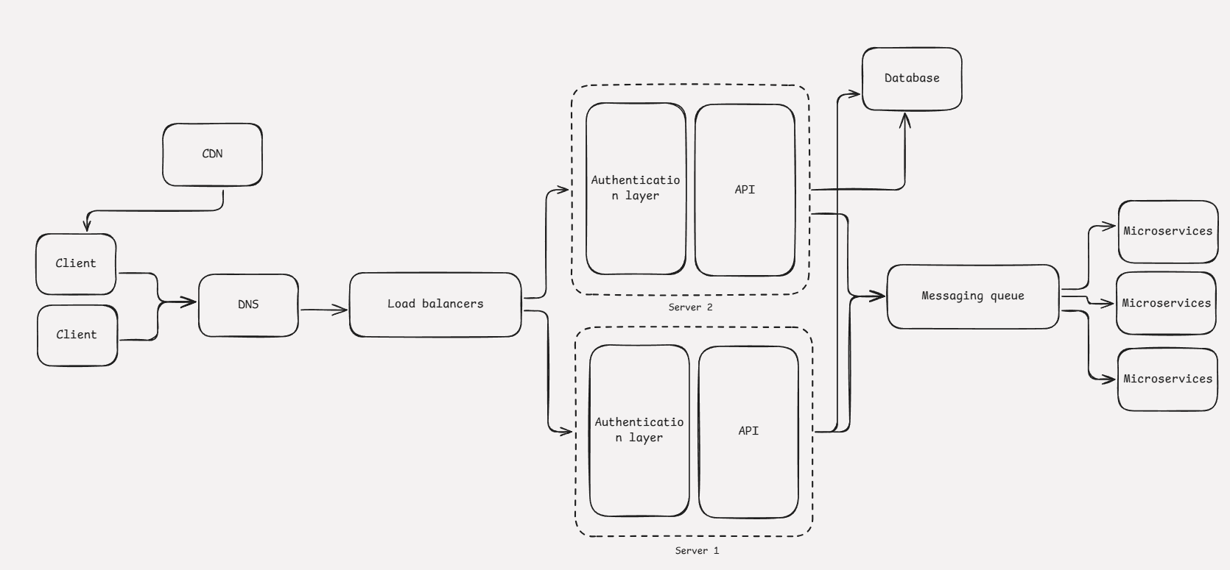
Full-stack application in a nutshell
Prepared by: Ali Ahnaf

Slide 6
Common Components
DNS (Domain name system): DNS resolves the human-readable domain name (e.g., www.example.com) into the IP address of the load balancer or the server it points to.
Load balancers: Distributes incoming client requests across multiple backend servers and ensures no single server is overloaded. Provides high availability and fault tolerance by redirecting traffic from a failed server to healthy servers.
Messaging queue: Acts as a message broker to handle asynchronous communication. Backend Servers send tasks or events (e.g., data processing, email notifications) to the queue. The queue takes these tasks, send them to the microservices. It helps decouple the services and enable asynchronous communication. Without a queue, service A must know how to communicate with service B and it must wait for Service B to process the request and respond, causing delays.
Micro-services: collection of small, independently deployable services. Each service focuses on a specific business logic. Each service is isolated and can scale independently based on its workload.
Prepared by: Ali Ahnaf

Slide 7
What are Frameworks?
Frameworks are a pre-built software structure or foundation designed to simplify and standardize the development of application. They offer ready-to-use components, libraries, and modules, saving time on repetitive tasks.
Examples of popular web frameworks include NextJs, AngularJs, Laravel (for PHP) etc.
SS: Libraries vs Frameworks
Prepared by: Ali Ahnaf

Slide 8
Introduction to Laravel
Laravel is a backend framework that provides all of the features you need to build modern web applications, such as routing, validation, caching, queues, file storage, and more. It provides a rich set of tools and features that simplify and accelerate web development while adhering to clean and maintainable code principles.
Some key features that comes out-of-the box include:
Dependency injection
Follows the Model-View-Controller (MVC) design pattern, separating the application's logic, presentation, and data layers for better organization.
Offers a clean and intuitive way to define web and API routes
Has a built-in Object-Relational Mapper (ORM) that simplifies database interactions using models that map directly to database tables.
Comes with tools to easily implement user authentication (login, registration, password reset) and authorization (roles, permissions)
Protects applications from common vulnerabilities like SQL injection, cross-site scripting (XSS), and cross-site request forgery (CSRF).
Prepared by: Ali Ahnaf

Slide 9
Installation guide
To install laravel, the following needs to be installed: PHP, composer, and laravel installer.
Open a windows powershell as administrator and run the following command to install both PHP and composer:
Set-ExecutionPolicy Bypass -Scope Process -Force; [System.Net.ServicePointManager]::SecurityProtocol = [System.Net.ServicePointManager]::SecurityProtocol -bor 3072; iex ((New-Object System.Net.WebClient).DownloadString('https://php.new/install/windows/8.4'))
Install laravel globally with this command [optional]: composer global require laravel/installer
In a new command prompt, type composer -v to check if it has installed successfully.
Prepared by: Ali Ahnaf

Slide 10
Composer
Composer is a dependency management tool for PHP. It allows developers to manage libraries, frameworks, and packages that their PHP project depends on. It is similar to npm.
Common Commands
composer init - Initializes a new project and creates composer.json.
composer require <package> - Adds a package to your project.
composer install - Installs all dependencies from composer.json.
composer update - Updates packages to the latest versions.
composer dump-autoload - Regenerates the autoload files.
composer remove <package> - Removes a package.
Prepared by: Ali Ahnaf

Slide 11
Composer
Example: Let’s say we add a new package with composer require guzzlehttp/guzzle
Composer downloads the guzzlehttp/guzzle package and all its dependencies into the vendor directory. It then generates an autoload.php file under the vendor directory, which we import (require) it in our php file (typically in the index.php file).
<?php
require 'vendor/autoload.php';
use GuzzleHttp\Client;
$client = new Client();
By requiring vendor/autoload.php, all installed packages and their classes are automatically made available to your project.
Prepared by: Ali Ahnaf

Slide 12
Frontend approaches (for SSR)
There are two primary ways to tackle frontend development when building an application with Laravel:
1. Using PHP and Blade: In the past, most PHP applications rendered HTML to the browser using simple HTML templates interspersed with PHP statements which render data. But now, this is done using Blade. Blade is an extremely lightweight templating language that provides convenient, short syntax for displaying data.
<div>
@foreach ($users as $user)
Hello, {{ $user->name }} <br />
@endforeach
</div>
Prepared by: Ali Ahnaf

Slide 13
Frontend approaches (for SSR)
2. Using Javascript frameworks: as user expectations regarding web applications have matured, many developers have found the need to build more dynamic frontends with interactions that feel more polished, such as React or Vue.
Inertia bridges the gap between your Laravel application and your modern React frontend. It works the same as before, but instead of returning a Blade template from your controller, you will return an Inertia page:
class UserController extends Controller
{
public function show(string $id): Response
{
return Inertia::render('Users/Profile', [
'user' => User::findOrFail($id)
]);
}
}
An Inertia page corresponds to a React component, typically stored within the resources/js/Pages directory of your application
Prepared by: Ali Ahnaf

Slide 14
Scaffolding project (API only)
The fastest way to get started with Laravel and React is by beginning your application's development using Laravel Breeze.
Laravel Breeze is a simple and lightweight starter kit for Laravel applications that contains all of Laravel's authentication features ready-to-use out of the box. It offers scaffolding a React/Vue application using classic server-side routing and controllers. It can also be used to scaffold an API only application.
Run these commands to scaffold an API application with laravel:
composer create-project laravel/laravel api-backend // scaffolds app
cd api-backend // enter the project directory
composer require laravel/breeze --dev // installs laravel breeze php artisan breeze:install api // scaffolds an API app
Finally, run php artisan serve to start the API using the built-in development server
Prepared by: Ali Ahnaf

Slide 15

Prepared by: Ali Ahnaf

Slide 16
MVC pattern
MVC is a design pattern used to decouple user-interface (view), data (model), and application logic (controller). Requests are routed to a Controller that is responsible for working with the Model to perform actions and/or retrieve data. The Controller chooses the View to display and provides it with the Model. The View renders the final page, based on the data in the Model.
Client-side MVC applications typically use AJAX calls to fetch data from the server, allowing for dynamic updates without full page reloads.
Core jobs of the controller:
Handle user requests and responses
Input validation
Authorization
Prepared by: Ali Ahnaf

Slide 17
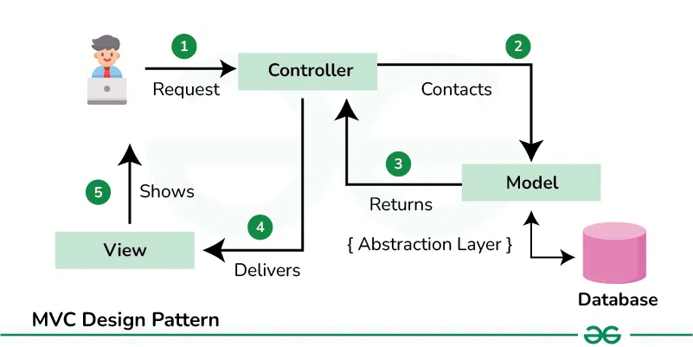
MVC pattern
Prepared by: Ali Ahnaf

Slide 18
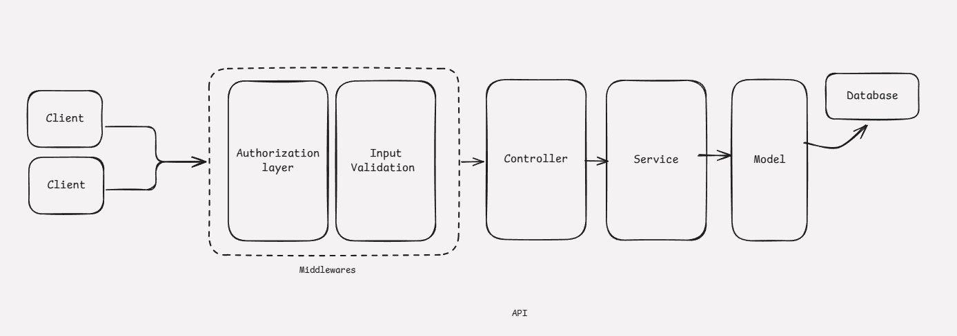
Decoupling the flow
Prepared by: Ali Ahnaf

Slide 19
Directory structure
Everything you see in the fresh project (outside of vendor) is what is required to wire the framework together with some examples of how to do things (for e.g controller, example view, etc).
api-backend/
├── app/
│ ├── Console/Kernel
│ ├── Exceptions/Handler
│ ├── Http/
│ │ ├── Controllers/
│ │ ├── Kernel
│ ├── Models/
│ ├── Providers/
│ └── Services/
app: The app directory contains the core of the Laravel application
Console/Kernel: Every console command passes through it. It also handles scheduled tasks, like cron jobs
Exceptions: Whenever your application throws an exception that isn't handled by your own code, it will end up here.
Http/Kernel: Every HTTP request passes through it. It forwards requests to the routing layer and handles middleware functionality
Http/Controller: used to store classes responsible for handling incoming HTTP requests and returning appropriate responses
Models: Contains Eloquent (ORM) models for database interaction.
Providers: Contains service providers which bootstrap various services for the application
Services: Encapsulate business logic or external API interactions that don't belong directly in the controller or model
Prepared by: Ali Ahnaf

Slide 20
Directory structure
Everything you see in the fresh project (outside of vendor) is what is required to wire the framework together with some examples of how to do things (for e.g controller, example view, etc).
├── bootstrap/
│ └── cache/
├── config/
├── database/
│ ├── factories/
│ ├── migrations/
│ └── seeders/
├── public/
├── resources/
bootstrap/cache: caches some stuff for better performance
config: contains all configuration files (env) for your application (e.g., database.php, app.php, queue.php)
database: database migrations, seeders and factories.
factories/: initializes default data for models
migrations/: migration files that define the database schema.
seeders/: seeder files for populating the database with sample data.
public: contains the index.php file, which is the entry point for all requests entering your application and configures autoloading. This directory also houses your assets such as images, JavaScript, CSS
resources: contains resources for views, raw assets, and language files. When using SSR, the js directory hosts the blade/react/vue files
Prepared by: Ali Ahnaf

Slide 21
Directory structure
Everything you see in the fresh project (outside of vendor) is what is required to wire the framework together with some examples of how to do things (for e.g controller, example view, etc).
├── routes/
│ ├── web.php
│ ├── api.php
│ ├── console.php
│ ├── channels.php
│ ├── auth.php
routes: contains all of the route definitions in the application
web.php: define routes that handle HTTP requests made to your web application, typically for rendering views. Not required for applications that hosts API only.
api.php: contains routes that are intended to be stateless, so requests entering the application through these routes are intended to be authenticated via tokens and will not have access to session state
console.php: a special file used for registering custom artisan commands that you can run from the command line. Not used for web or API requests.
auth.php: contains authentication-related routes, such as login, signup etc
Prepared by: Ali Ahnaf

Slide 22
Directory structure
Everything you see in the fresh project (outside of vendor) is what is required to wire the framework together with some examples of how to do things (for e.g controller, example view, etc).
├── storage/
│ ├── app/
│ ├── framework/
│ └── logs/
├── tests/
├── .env
├── .gitignore
├── artisan
├── composer.json
├── .styleci.yml
├── webpack.mix.js
storage: contains logs, compiled Blade templates, file based sessions, file caches, and other files generated by the framework
app/: stores uploaded files, backups, and other app-related files.
framework/: stores session files, cache, and other framework-related files.
logs/: stores log files
tests: contains the test files for the application webpack.mix.js: used to build frontend assets through webpack artisan: responsible for running various artisan commands in your application, such as database migrations, generating code for controllers, models, and more.
styleci.yml: a continuous integration (CI) service for automatically formatting PHP code to meet specific coding standards when pushed to a remote repository
Prepared by: Ali Ahnaf

Slide 23
Project proposal
Team members: List the roll numbers, name, email and roles of your mates (minimum 3 and maximum 4)
Project Overview: Provide a brief and clear description of your project idea, including:
Project Title: A short and descriptive name for your project.
Objective: What problem will your project solve, or what purpose does it serve?
Target Audience: Who are the intended users of your application?
Tech Stack: Clearly mention the technologies you will use:
Backend: Laravel (mandatory).
Frontend: Choose a framework or library of your choice (e.g., React, Vue, Angular etc).
Rendering Method: Decide whether you will use:
Server-Side Rendering (SSR), or
Client-Side Rendering (CSR).
Prepared by: Ali Ahnaf

Slide 24
Project proposal
UI Design
Mock UI: Design a mock user interface for your project using Figma or any similar UI/UX design tool (Adobe XD, Sketch, Canva, etc.).
Provide a link to your Figma (or equivalent) design in your README file
Project Features: List the main features your project will include, for example:
User authentication (registration & login etc)
CRUD operations (Create, Read, Update, Delete) for specific data.
What API endpoints you will be using, ie:
GET /story
POST /story
Milestones: Divide your project timeline into 3 milestones. List what features you will implement in each milestone.
Prepared by: Ali Ahnaf

Slide 25
Project proposal
Submission guidelines: You are required to document the project proposal in the README.md file of your GitHub repository.
Create a new repository in your github account.
Name it something relevant to your project title.
Add your instructors to the project as collaborators.
aliahnaf327@gmail.com
Create a README.md file and add your project proposal details.
Push the changes to the default branch (typically master)
A form will be provided where you will submit the gitHub repository link to the instructor for final evaluation.
Bring a hardcopy of your printed README.md
Bonus: suggest to use github submodules for each of the projects (API, client, and database)
Prepared by: Ali Ahnaf

Slide 26
Team Roles
Role | Responsibilities
Lead | Manage issues and milestones. Organize scrum meetings daily to track progress Assist in both front-end and back-end tasks as needed.
Front-end Developer | Develop the user interface using HTML, CSS, and React/Vue/Angular. Ensure responsive and visually appealing design. Integrate front-end with back-end APIs.
Back-end Developer | Set up the Laravel project and database. Develop the API endpoints. Handle server-side logic and data manipulation. Ensure security and data validation. Deploy the project and manage backend configurations.
Prepared by: Ali Ahnaf

Slide 27
Featured project ideas
Attendance tracker (B2) ⭐: An attendance tracking platform for instructors. Required features include:
Google SSO
Admin, instructor and student portal with redesigned UI
Classroom judge (B1)⭐: A classroom engagement tool for live quizzes, polls, and competitions, similar to Zylabs
A platform to trade items (A2) ⭐: similar to TradeMade
Paikari - Real time price lookup: A webapp like price.com
Rent management portal (B1)
A community driven platform to review doctors
A platform to report incidents going around in the country
Project marked with ⭐ will be personally supervised by me. But it also means, they will have more requirements, strict reviews and tight deadlines.
Prepared by: Ali Ahnaf

Slide 28
Notable VS code extensions
Laravel Extra Intellisense - Visual Studio Marketplace
PHP - Visual Studio Marketplace
Prepared by: Ali Ahnaf

Slide 29
References
Directory structure | Reddit
Directory Structure - Laravel 11.x - The PHP Framework For Web Artisans
Starter Kits - Laravel 11.x - The PHP Framework For Web Artisans
Getting Started with React in Laravel

Slide 30
Classwork
Mr. Jahangir owns a growing home-cleaning service agency with over 25 cleaning teams. His current method of managing bookings, team assignments, cleaning supplies inventory, and payments is entirely manual, using paper records. As a result, he frequently faces issues such as double-booking clients, assigning the wrong teams, running out of cleaning supplies due to lack of tracking, and delayed or missed payments from clients.
To address these challenges, a web application is needed to digitize and automate operations. The system should provide the following features:
Client Registration & Authentication: Clients should be able to create accounts, log in, and manage their cleaning service bookings.
Smart Team Assignment: The system should automatically assign cleaning teams based on availability, proximity to the client’s location, and team capacity.
Inventory Management: Track the stock of cleaning supplies and send alerts when restocking is required.
Payment Management: Allow clients to pay for services online and send reminders for any outstanding payments.
Real-Time Job Tracking: Enable Jahangir to monitor which teams are currently cleaning, their locations, and their progress.
Prepared by: Ali Ahnaf

Slide 31
Classwork
Instructions
Make a group of 4 people
Create an architecture of the entire system
Create mock UIs for the website in a blank page (ie- login page, homepage etc)
Design 5-7 key API routes for the application and describe what they will do, ie:
POST /sign-in -> signs a user into the system and attaches a token with roles
Present your solution to the class
Make sure to consider security issues and efficiency of your architecture. For example, are you using caching, if so why? Can your system account for huge traffic at peak times?
Prepared by: Ali Ahnaf

